Slide 1
NETWORK PROJECT 2019
IMAGE EDITOR WITH MATCHER
201707367
K.R TAMBO

Slide 2
PROBLEM STATEMENT
With 4IR taking over the world. Improved image editing tools are now required to match up with the speeding technology. Together with the expanding movie industry, people need to know their movie stars from a close age and understand the person behind the character. Current image editors cannot match an image of an actor to its corresponding real life person. It becomes difficult to match images that are even distorted or blurred.

Slide 3
SOLUTION
Create a java based GUI that communicates to the provided server
Give user ability to chose a desired image of an actor
Let server edit the chosen image
Link images to the internet to collect information about actor
Provide a clear image of the actor that is visible to user

Slide 4
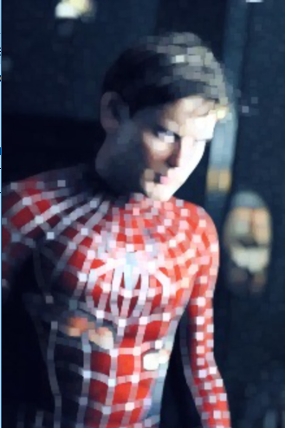
METHODOLOGY
Create a java based GUI based on javafx in the client side
Images can be selected from localhost machine or downloaded from the internet
Establish a connection between the application and server
Client communicates with server to edit the image

Slide 5
Methodology continued
On mouse click, application provides the person behind the image
Information is conveyed to the user
4 editing features are provided to edit selected image
Application communicates with internet to provide data

